Slide 1
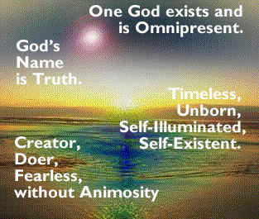
characteristics of Sikh religion
Sikhism is a monotheistic faith.
It recognizes God as the only One. He who is not subject to time or space.
He who is the Creator, Sustainer and Destroyer of the Universe.

Slide 2
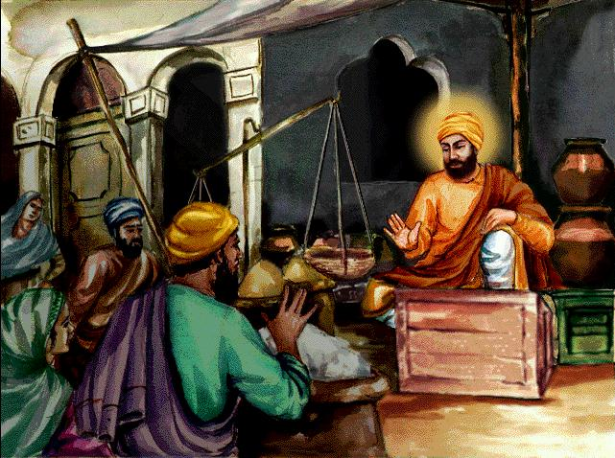
Moreover in Sikhism, ethics and religion go together.
The inculcation of moral qualities and the practice of virtue in everyday life is a vital step towards spiritual development.
Qualities like honesty, compassion, generosity, patience, humility etc. can be built up only by effort and perseverance
The lives of the Gurus show how they lived their lives according to their code of ethics
At Sultanpur ( Nawab Daultat Khan)
Storekeeper and Accountant
Work, Prayer and Helping the needy

Slide 3
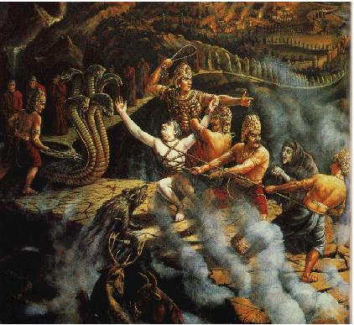
Sikhism does not believe in Avtarvada, that God takes a human form.
It does not attach any value to gods and goddesses and other deities
The Sikh religion rejects all rituals and routine practices like fasting and pilgrimage, omens and austerities.
The goal of human life to merge with God is accomplished by following the teachings of the Guru, by meditation on the holy Name and performance of acts of service and charity.
Sikhism does not believe in Avtarvada, that God takes a human form. and does not attach any value to gods and goddesses and other deities

Slide 4
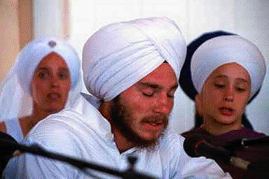
Sikhism emphasizes Bhakti Marg or the path of devotion.
It does, however, recognizes the limited value of Gian Marg (Path of Knowledge) and Karam Marag (Path of Action).
It also lays stress on the need for earning God's Grace in order to reach the spiritual goal.
Bhakti Marg or the path of devotion

Slide 5
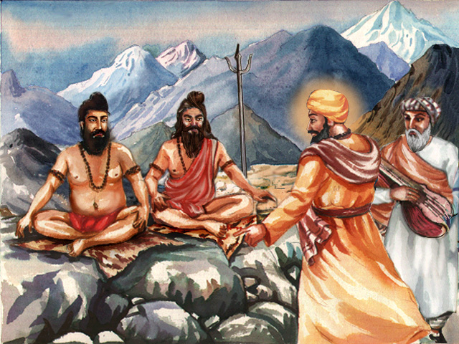
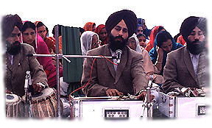
Sikhism is a modern, logical, and practical religion.
It believes that normal family-life (Grasth) is no barrier to salvation.
That it is possible to live detached in the midst of worldly ills and temptations.
A devotee must live in the world and yet keep his head above the usual tensions and turmoil.
He must be a soldier, scholar and saint for God.
Guru Nanak dev ji to sidhs -- family-life (Grasth) is no barrier to salvation
possible to live detached in the midst of worldly ills and temptations.

Slide 6

The Gurus believed that this life has a purpose and a goal.
It offers an opportunity for self and God realization.
Moreoever man is responsible for his own actions.
He cannot claim immunity from the results of his actions He must therefore be very vigilant in what he does
GOOD
BAD
man is responsible for his own actions.

Slide 7
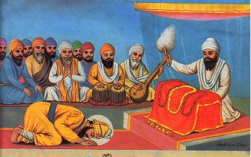
Finally, the Sikh Scripture (Sri Guru Granth Sahib) is the perpetual Guru.
This is the only religion which has given the Holy Book the status of a religious preceptor.
There is no place for a living human Guru (Dehdhari) in Sikh religion
GURGADI AT NANDED

